Slide 1

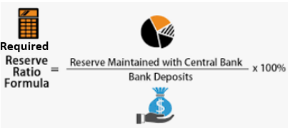
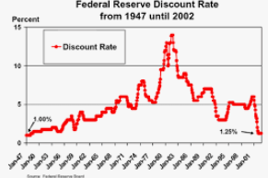
When the 3 Tools of MP Apply
These three tools we have looked at:
Open Market Operations, Required Reserve Ratio, Discount Rate
However, these only apply in an economy that has limited reserves.
We will look at this in detail in the next section.
Open Market Operations (OMO)
Buy bonds = increase the money supply -> decrease the interest rate
Sell Bonds = decrease the money supply -> increase interest rate
Remember: Buy Bonds = Big (increase money supply), Sell Bonds = Small (decrease money supply)
3. Discount Rate
Increase Discount Rate – decrease the money supply -> increase interest rate
Decrease Discount Rate – increase the money supply -> decrease interest rate
2. Required Reserve Ratio (RRR)
Increase RRR – decrease the money supply -> increase interest rate
Decrease RRR – increase the money supply -> decrease the interest rate
Securities = bonds
(or any other financial assets)

Slide 2
Limited Reserves vs Ample Reserves
We will soon see that the three tools of monetary policy that we have covered apply when the economy has limited reserves.
In an ample reserves economy, different policy actions must be taken.

Slide 3

Three Tools of Changing Money Supply for Monetary Policy
Plus one extra!
Three Tools of Monetary Policy
Open Market Operations (OMO)
Buy bonds = increase the money supply -> decrease the interest rate
Sell Bonds = decrease the money supply -> increase interest rate
Remember: Buy Bonds = Big (increase money supply), Sell Bonds = Small (decrease money supply)
3. Discount Rate
Increase Discount Rate – decrease the money supply -> increase interest rate
Decrease Discount Rate – increase the money supply -> decrease interest rate
2. Required Reserve Ratio (RRR)
Increase RRR – decrease the money supply -> increase interest rate
Decrease RRR – increase the money supply -> decrease the interest rate
???
Another Monetary Policy Tool!
Securities = bonds
(or any other financial assets)

Slide 4
Three Tools of Changing Money Supply for Monetary Policy
Plus one extra!
Three Tools of Monetary Policy
Open Market Operations (OMO)
Buy bonds = increase the money supply -> decrease the interest rate
Sell Bonds = decrease the money supply -> increase interest rate
Remember: Buy Bonds = Big (increase money supply), Sell Bonds = Small (decrease money supply)
3. Discount Rate
Increase Discount Rate – decrease the money supply -> increase interest rate
Decrease Discount Rate – increase the money supply -> decrease interest rate
2. Required Reserve Ratio (RRR)
Increase RRR – decrease the money supply -> increase interest rate
Decrease RRR – increase the money supply -> decrease the interest rate
“Ample Reserves” Monetary Policy
We will soon see this is about lowering the ‘administered interest rates’.
Securities = bonds
(or any other financial assets)
“Limited Reserves” Monetary Policy

Slide 5
How many tools of monetary policy do we have in this course?
Four!
3 of the ‘normal ones’
OMO, Discount Rate, Reserve Ratio
+ One new one: Ample Reserves Monetary Policy

Slide 6
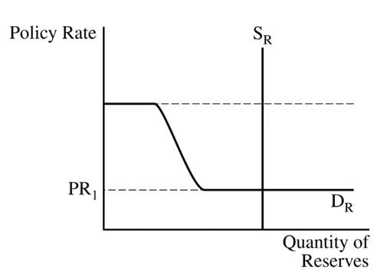
Quick Summary
Deeply understanding this section is more difficult than understanding the bare minimum to answer the questions.
With an ample reserves economy we have to consider this Reserves Market Graph.
Policy Rate (PR) – in the US, the Federal Funds Rate (FFR), the rate that banks pay when they lend to each other.
Policy Rate
These are just different types of interest rates!
Discount Rate (DR) – rate that commercial banks pay to borrow from the Fed.
Eg. 6%
Administered Interest Rates
Interest on Reserves (IOR) – rate that the Fed pays to banks for keeping reserves.
Eg. 0.5%
Most important thing for you:
The Fed can influence the Policy Rate (FFR):
Expansionary MP – ↓IOR and Discount Rate -> lowers the PR (FFR) → ↑AD
Contractionary MP – ↑IOR and ↑Discount Rate → ↑PR (FFR) → ↓AD

Slide 7
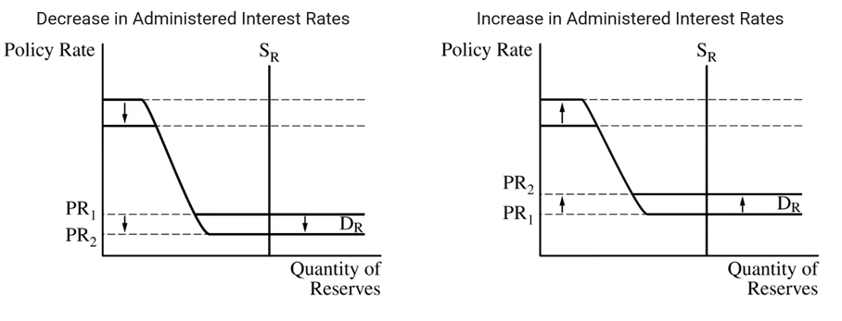
Most important thing for you:
The Fed can influence the Policy Rate (FFR):
Expansionary MP – lower the IOR and Discount Rate -> lowers the PR (FFR)
Contractionary MP – increase the IOR and Discount Rate -> increases the PR (FFR)
Expansionary MP (lowering IR)
Contractionary MP (increasing IR)

Slide 8
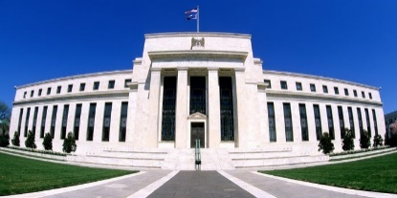


Limited Reserve Economy vs Ample Reserve Economy
Summary
Limited reserves economy – increasing MS will have an effect on lending and the IR
Ample reserves economy – increasing MS will have no effect
Definition: Ample = a lot of something
Normal MP: Limited Reserves (∆MS still affects lending and the IR)
All of our study of money supply and the effect on the interest rate so far applies in a situation where an economy has relatively scarce reserves ie. limited reserves.
In a situation with limited reserves, there will be a relationship between the supply of reserves and the interest rate, because banks will have more reserves to lend out and can lower their interest rates.
Ample Reserves (∆MS has no effect on lending and IR anymore)
When an economy has so called ample reserves, this changes the natre of the monetary policy.
After a certain point, more reserves don’t make a difference to the interest rate.
Therefore, the Fed must act differently to try and control the interest rate.
We already have more than enough reserves, so this doesn’t affect how much we will lend or the interest rates.
We have more reserves now, so we can lend out more and lower interest rates!
Money Supply
Money Supply

Slide 9
What are the two situations the economy can be in with regards to the effectiveness of changing money supply on interest rates?
Limited Reserves Economy – ∆MS-> ∆IR
Ample Reserves Economy - ∆MS-> no effect on the IR
In what situation are the 3 tools of MP: OMO (buy and sell bonds), change RRR, and change discount rate, effective?
When we have a limited reserves economy.

Slide 10
Conditions of an Ample Reserves Economy
Summary
When there are so many reserves in the economy, there is no longer an effect of increasing MS.
Limited reserves economy – 3 tools of MP can be used (OMO,
Ample reserves economy – other tools must be used
Ample Reserves Economy
Reserves are abundant
The required reserve ratio is zero – banks have no restriction on what they can lend
Changing the MS no longer leads to changes in nominal interest rates
Different monetary policy tools are needed
Hmmm… How can we stimulate the economy?
We already have more than enough reserves, so this doesn’t affect how much we will lend or the interest rates.
Money Supply

Slide 11
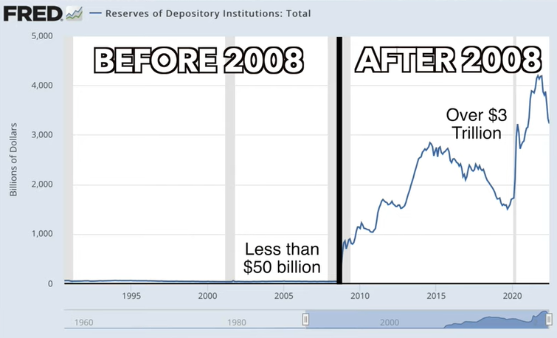
Banks were lending a lot! So they kept little reserves
After the financial crisis of 2009, banks were given a lot of money to try and encourage lending, but it was only partially effective.

Slide 12
What are some conditions of an ample reserves economy?
Lots of reserves!
RRR is zero
The MS is so large that it no longer affects the IR
Different policy tools are needed

Slide 13
Interest Rates
We have to examine a few different interest rates on this topic of Ample Reserves Monetary Policy.

Slide 14
Policy Rate = Federal Funds Rate
Summary
The Policy Rate is also called the Federal Funds Rate.
It is the interest rate that commercial banks charge each other.
Policy Rate = The Federal Funds Rate
Commercial banks often lend to each other and they also charge an interest rate. This rate is called the Federal Funds Rate.
Federal Funds Rate – the rate that commercial banks charge each other when they lend.
Policy Rate
Loan
US Name:
Federal Funds Rate
Loan + Interest
Federal Funds Rate

Slide 15
What is the Federal Funds Rate?
Federal Funds Rate – interest rate when commercial banks lend to each other.

Slide 16
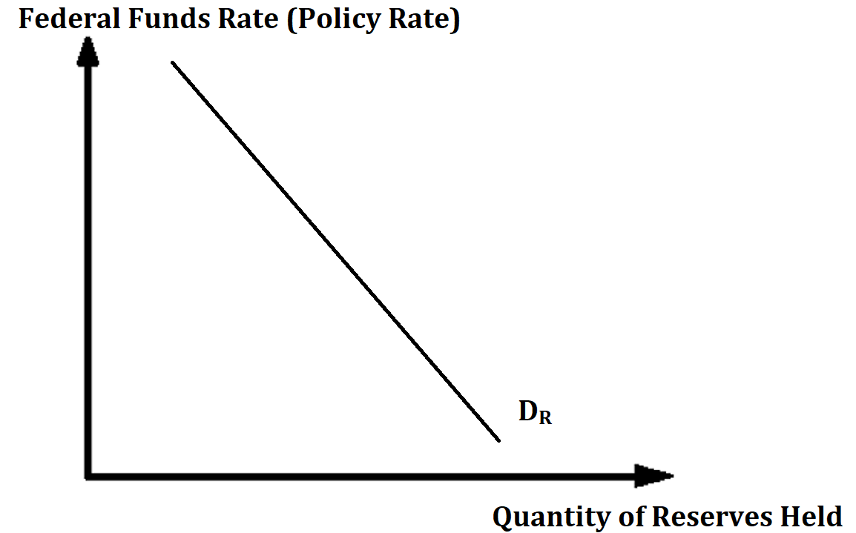
Demand of Reserves
Summary
Banks have demand for reserves.
The cost of having reserves is the interest rate that they could have earned (the federal funds rate).
Low Policy Rate = high quantity of reserves demanded
High Policy Rate = low quantity of reserves demanded
Banks often hold reserves. Their decision to hold reserves can be affected by the interest rate.
When the federal funds rate is high, banks would prefer to hold less reserves, because they can lend their money out instead and earn interest.
When the federal funds rate is low, banks will be more willing to hold reserves, because they are not giving up as much earned interest from loans.
Therefore the relationship between reserves and federal funds rate (the cost of holding reserves) is negative (which is true for all demand curves).

Slide 17
Do commercial banks demand more or less reserves when the federal funds rate is high?
Less, because they can make more money by having less reserves and lending out their reserves.
What is the relationship between the demand for reserves and the federal funds rate (policy rate)?
Negative, because the federal funds rate (policy rate) is essentially the ‘cost’ of holding reserves.
High Policy Rate – banks can make a lot of money with their loans
Low Policy Rate – banks can’t make as much money from their loans and can therefore hold more reserves without giving up too much

Slide 18
More Interest Rates
Summary
The Administered Rates are controlled by the Fed. They are:
Interest on reserves – interest the Fed pays banks for keeping reserves.
Discount Rate – interest rate that the Fed charges commercial banks to borrow.
You have borrowed some money from us… you must pay us interest according to the Discount Rate.
Discount Rate
We have already covered the discount rate – the interest rate that the Federal Reserve charges when commercial banks borrow from the Fed
Loan
Administered Rates
Called this because it are rates that the Fed has direct control over.
Remember, these are all just different types of interest rate.
Discount Rate
You are keeping some reserves with us. We will pay you some interest called Interest on Reserves.
Interest on Reserves
the Central Bank actually pays commercial banks to hold reserves interest on the reserves that the commercial banks keep with the central bank.
Reserves
Interest on Reserves

Slide 19


Different Interest Rates Summary
Both controlled by the Fed.
Policy Rate (PR)
Administered Interest Rates
Discount Rate (DR)
Banks pay to the Fed for loans
Interest on Reserves (IOR)
The Fed pays to banks for reserves
Federal Funds Rate (FFR)
Bank to bank
Loan
Reserves
Loan
Loan + Interest
Discount Rate
Interest on Reserves
Federal Funds Rate

Slide 20
What is the difference between the discount rate and the federal funds rate?
Discount Rate – interest rate when the Fed lends to commercial banks.
Federal Funds Rate – interest rate when commercial banks lend to each other.
What is the interest rate that is paid to commercial banks when they hold reserves with the Federal Reserve?
Interest on Reserves
Paid to commercial banks from the Federal Reserve

Slide 21
Relationship between Administered Interest Rates and Policy Rate
Summary
The administered rates are used by the Fed to try and influence the Policy Rate.
Administered Interest Rates
The administered rates are those controlled by the Fed.
The Fed tries to use these to influence the policy rate.
Interest on Reserves
Discount Rate
Policy Rate (PR)
Used to try and influence
Federal Funds Rate (FFR)
Bank to bank
= market interest rate
= federal funds rate

Slide 22
What are the two administered interest rates? How are they controlled?
The two administered interest rates are:
Interest on Reserves
Discount Rate
These can be directly controlled by the Fed. Eg. The Fed can lower both of these by 0.5% if they choose to.
What is another term for the policy rate?
The Federal Funds Rate – the rate of interest when banks lend to each other.
The Fed wants to influence this rate.

Slide 23
Guess the answer:
Even without looking at the material, if I were to ask you:
What do you think will be expansionary MP? Increasing the administered interest rates or decreasing the administered interest rates. Why?
DECREASING the administered interest rates.
Why? Expansionary MP is always about LOWERING interest rates to encourage more borrowing.

Slide 24
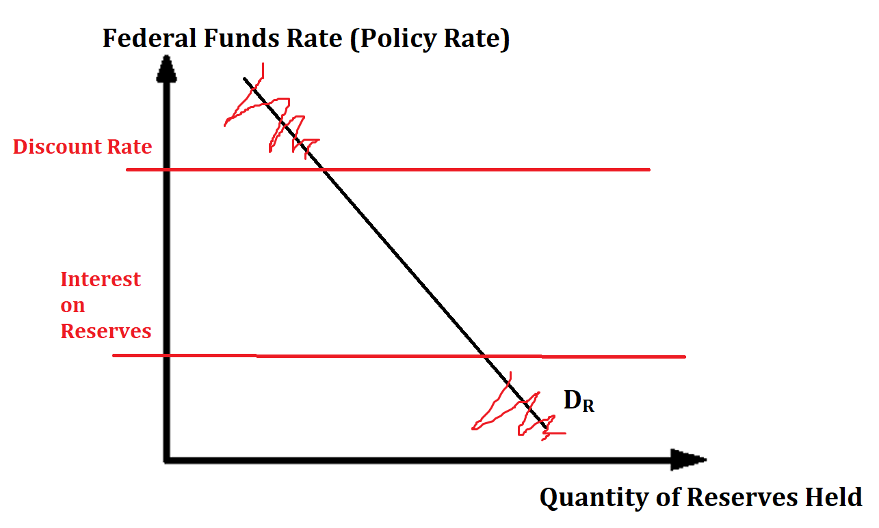
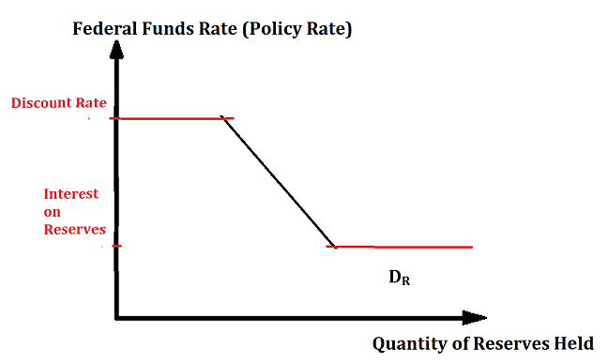
Administered Interest Rates and Reserve Demand
The Discount Rate and IOR has an effect on the shape of the D_{R} curve.

Slide 25
Explaining the Strange Shape of Demand for Reserves
We assume the supply of reserves (which is related to the MS) is controlled by the Fed and is therefore vertical.
The demand curve for reserves has two horizontal parts.
A: Discount Rate – if the federal funds rate is higher than the discount rate, commercial banks will not lend to each other and therefore not demand any reserves, because they can borrow from the Fed instead for cheaper. So banks won’t bother
B: Interest on Reserves (IOR) Banks will want to hold as many reserves as possible if the federal funds rate is lower than the IOR because they can earn higher interest this way.
Discount Rate
Interest on Reserves

Slide 26
Why the Discount Rate Creates a Horizontal Curve Effect
Example:
Discount Rate = 6%
Federal Funds Rate = 7%
Banks can choose between borrowing for 7% interest from other banks or 6% from the Fed.
Any commercial bank will choose to borrow from the Fed instead.
Therefore, the interest rate effectively cannot go above 6%.

Slide 27
Why the Interest on Reserves Creates a Horizontal Curve Effect
Example:
Interest on Reserves = 2%
Federal Funds Rate = 1%
Banks can choose between making 2% from the Fed by keeping reserves or earning 1% by lending to other commercial banks.
Therefore, the interest rate effectively cannot go below 2%.
= IOR₁

Slide 28
Explain the odd shape of the demand for reserves.
The demand for reserves would be a normal, downward sloping demand curve, however it has two horizontal parts.
Upper horizontal part – Discount Rate
Once the federal funds rate approaches the discount rate, there will be no reason for banks to lend to each other, because they can borrow from the Fed instead. So the interest rate cannot go above this level.
Lower horizontal part – Interest on Reserves
Once the federal funds rate is as low on interest on reserves, commercial banks may as well keep all their money as reserves because they can earn the best interest rate from the Fed.

Slide 29
Equilibrium of Reserves
Summary
Demand of reserves – how much banks want to hold reserves that they can use to lend money and make profit.
Supply of reserves – set by the Fed and therefore vertical.
Demand of Reserves – banks wish to hold reserves for two reasons
For the purpose of covering their costs
Banks want reserves to earn interest from the Fed (who will pay the ‘Interest on Reserves’ rate)
Supply of Reserves – set by the Fed and therefore vertical
Equilibrium where Q_{D} = Q_{S}
The interest rate at this level is the equilibrium Policy Rate (PR), also known as the Federal Funds Rate.

Slide 30
Why is the supply of reserves vertical?
It is set by the Federal Reserve/the Fed.
What is the interest rate where the market for reserves is in equilibrium.
At the equilibrium Policy Rate (the equilibrium Federal Funds Rate)

Slide 31
Limited Reserve Range vs Ample Reserves Range
Limited Reserves Range
Ample Reserves Range

Slide 32
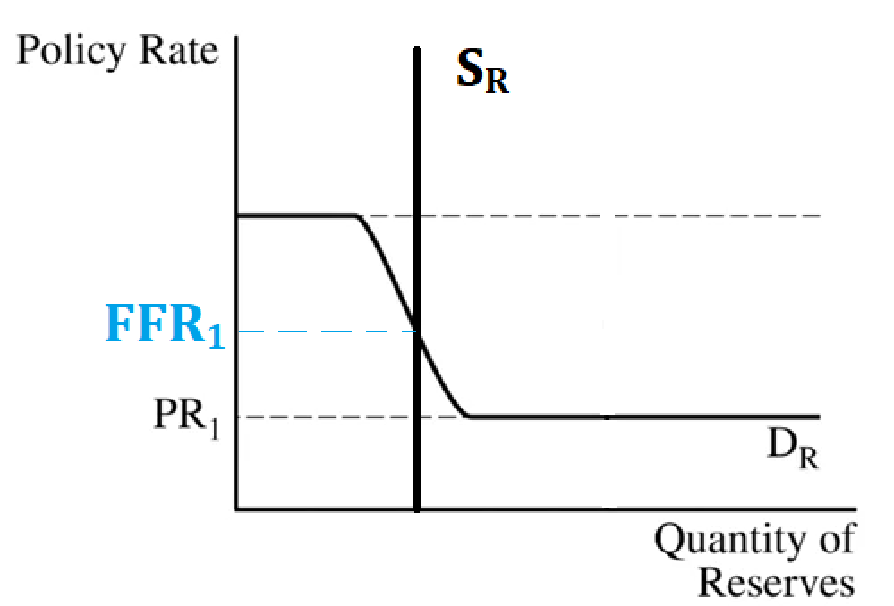



Limited vs Ample Reserves Equilibrium
Limited Reserves Equilibrium
Ample Reserves Equilibrium
For limited reserve economies we are typically on the downward sloping part of the curve.
For ample reserve economies we are always on the flat bottom part of the curve.

Slide 33
Draw a Market for Reserves graph where the economy has ample reserves. Show an ample reserves equilibrium.

Slide 34
Monetary Policy in an Ample Reserves Economy

Slide 35
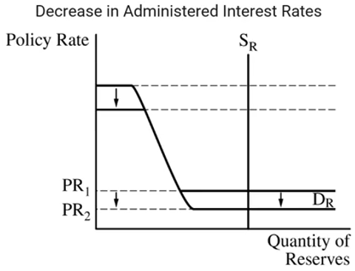
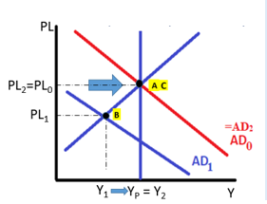
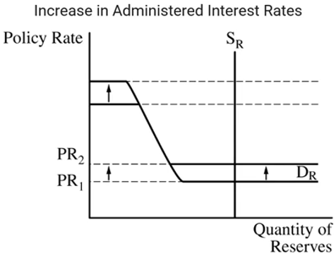
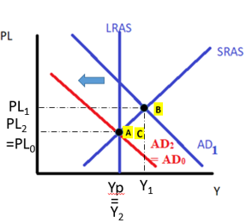
Monetary Policy with Ample Reserves
Summary
Monetary Policy (in an ample reserves economy) is done by changing the administered interest rates.
MP in an ample reserves economy is done by:
Expansionary MP
Contractionary MP
↓Administered Interest Rates → ↓Policy Rate → ↑Investment and Consumption → ↑AD
↑ Administered Interest Rates → ↑ Policy Rate → ↓ Investment and Consumption → ↓ AD
Note: The most important administered rate is the interest on reserves.

Slide 36
Remember that for all types of MP.
Increase any IR -> contractionary MP
Decrease any IR -> expansionary MP
So if you are unsure of a question, this simple fact will give you a chance to guess the right answer.

Slide 37
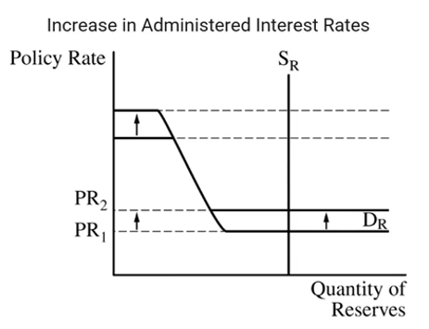
If the Fed wants to conduct contractionary MP in an ample reserves economy, what should it do with its administered interest rates?
It should increase the administered rates which will change the policy rate which will then decrease investment and consumption which will decrease AD.

Slide 38
Using the market for reserves, show how the CB can conduct expansionary and contractionary MP in an ample reserves economy.

Slide 39
Monetary Policy Tools Summary
Limited Reserves Economy
Change the Money Supply using:
Open Market Operations (OMO)
Required Reserve Ratio
Discount Rate
Ample Reserves Economy
Administered Interest Rates
Interest on Reserves (IOR)
Discount Rate
Will effect the market interest rate = federal funds rate = policy rate
Similarities in both cases
In both cases, the goal is still just to affect the interest rate! Therefore, lower IR = expansionary MP, higher IR = contractionary MP.

Slide 40
Which of the following is a MP tool for an ample reserves economy?
Changing the IOR
Changing the RRR
Answer: Changing the IOR
List a type of MP that works in a limited reserves economy?
Open market operations, RRR, Discount Rate
What is a key similarity in all the four different types of monetary policy?
If we want expansionary MP it is about LOWERING the interest rate to encourage more borrowing/investment/consumption.

Slide 41

Interest Rates Move Together
Summary
There are many different interest rates but it is not so complex because they move together.
Increase any IR = contractionary MP
Decrease any IR = expansionary MP
At this point it seems quite complex what we’ve studied so far.
We’ve looked at many different types of interest rate:
Nominal Interest Rate, Discount Rate, Federal Funds Rate, Interest on Reserves, Administered Rates, Policy Rates
This seems like far too many interest rates to understand!
Interest Rates move together
Increase in one IR -> increase in all IR
Decrease in one IR -> decrease in all IR
Significance for MP:
If any of these interest rates are lowered = expansionary MP.
If any of these interest rates are increased = contractionary MP.

Slide 42
A decrease in administered rates (administered interest rates) is an example of contractionary or expansionary MP?
Expansionary MP. Lower interest rate = more investment and consumption.
A government policy to increase the nominal interest rates of the economy is an example of contractionary or expansionary MP?
Contractionary MP. Higher interest rate = less investment and consumption.
There are many different interest rates, this means that questions about interest rates and MP will be extremely difficult. True/False.
False, because interest rates move together. So changing one interest rate really means changing all interest rates.

Slide 43
Quick Summary
Deeply understanding this section is more difficult than understanding the bare minimum to answer the questions.
With an ample reserves economy we have to consider this Reserves Market Graph.
Policy Rate (PR) – in the US, the Federal Funds Rate (FFR), the rate that banks pay when they lend to each other.
Policy Rate
Discount Rate (DR) – rate that commercial banks pay to borrow from the Fed.
Eg. 6%
Administered Interest Rates
Interest on Reserves (IOR) – rate that the Fed pays to banks for keeping reserves.
Eg. 0.5%
Most important thing for you:
The Fed can influence the Policy Rate (FFR):
Expansionary MP – lower the IOR and Discount Rate -> lowers the PR (FFR)
Contractionary MP – increase the IOR and Discount Rate -> increases the PR (FFR)

Slide 44
Most important thing for you:
The Fed can influence the Policy Rate (FFR):
Expansionary MP – lower the IOR and Discount Rate -> lowers the PR (FFR)
Contractionary MP – increase the IOR and Discount Rate -> increases the PR (FFR)
Expansionary MP (lowering IR)
Contractionary MP (increasing IR)

Slide 45
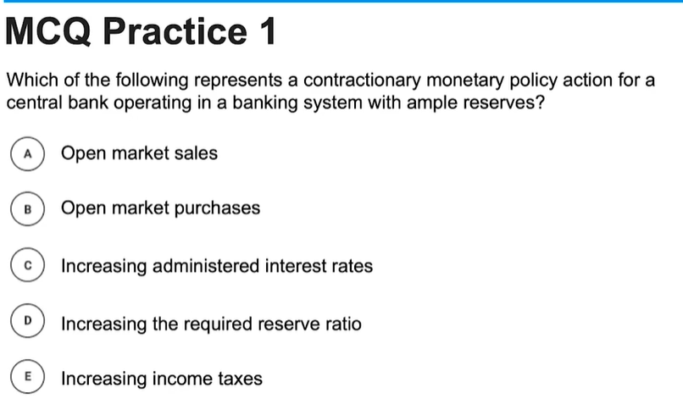
Answer:
C: Increasing administered interest rates.

Slide 46
If the Federal Reserve is concerned because the actual unemployment rate is greater than the natural rate of unemployment, what policy action could they take in an ample reserves economy?
Decrease interest on reserves
Decrease the required reserve ratio.
Decrease income taxes
Increase bond purchases
Increase administered interest rates.
Answer:
A. Decrease interest on reserves.

Slide 47
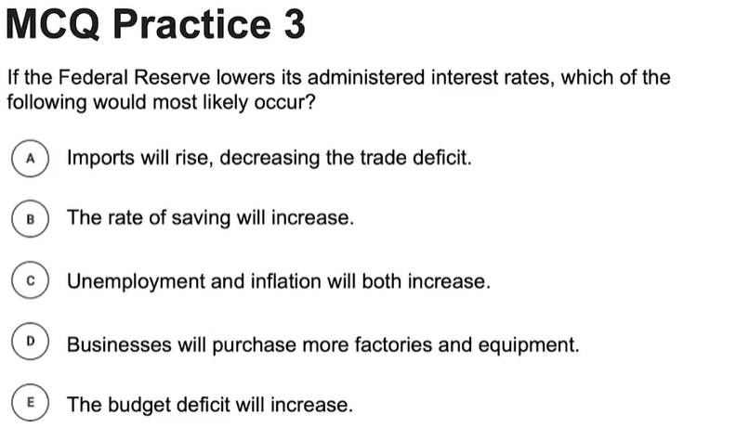
Answer:
D: Businesses will purchase more factories and equipment.
As always, lower interest = more investment.

Slide 48
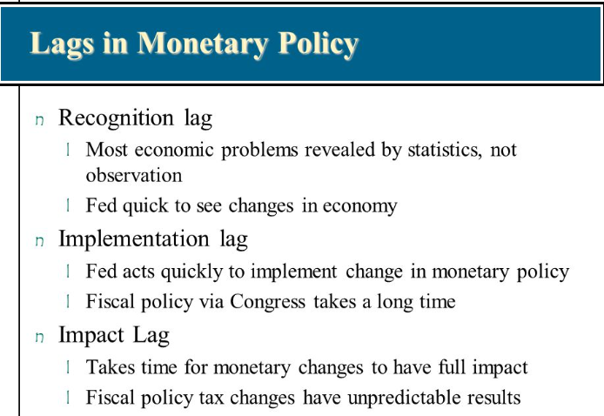
Monetary Policy Lags
Just like with Fiscal Policy, Monetary Policy also has lags, which causes the policy effect to not be immediate.
Recognition Lag / Data Lags – takes time to collect and analyze the data necessary to make monetary policy decisions.
Impact Lag / Implementation Lag – takes time for the economy to adjust and the for the policy to take effect.
So actually, MP doesn’t have as much implementation lag as does Fiscal Policy

Slide 49
What are some reasons that monetary policy will have a lag in its effectiveness.
Recognition Lag – collecting enough statistics to recognize the true condition of the economy.
Impact Lag – changes to interest rates may take some time to take effect and impact the economy.

Slide 50



Speed of Implementing Various Policies
Slowest
Discretionary Fiscal Policy
Data lags (eg. Collecting employment statistics to assess if the UR has increased)
Political Lags (eg. Passing the proposal to build a road)
Implementation lags (eg. Planning to build a road)
Monetary Policy
Data lags (eg. Collecting employment statistics to assess if the UR has increased)
Automatic Stabilizers (Non-discretionary fiscal policy)
Moderate
Fastest

Slide 51
Which kind of government intervention is typically slowest? Why?
Discretionary fiscal policy.
It has many lags including political lags, data lags and implementation lags.

